Slide 1
Oracle PL/SQL

Slide 2
Triggers
Associated with a particular table
Automatically executed when a particular event occurs
Insert
Update
Delete
Others

Slide 3
Triggers vs. Procedures
Procedures are explicitly executed by a user or application
Triggers are implicitly executed (fired) when the triggering event occurs
Triggers should not be used as a lazy way to invoke a procedure as they are fired every time the event occurs

Slide 4
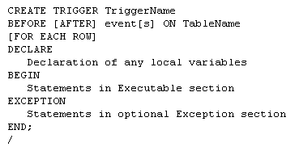
Triggers

Slide 5
Triggers
The trigger specification names the trigger and indicates when it will fire
The trigger body contains the PL/SQL code to accomplish whatever task(s) need to be performed

Slide 6
Triggers

Slide 7
Triggers Timing
A triggers timing has to be specified first
Before (most common)
Trigger should be fired before the operation
i.e. before an insert
After
Trigger should be fired after the operation
i.e. after a delete is performed

Slide 8
Trigger Events
Three types of events are available
DML events
DDL events
Database events

Slide 9
DML Events
Changes to data in a table
Insert
Update
Delete

Slide 10
DDL Events
Changes to the definition of objects
Tables
Indexes
Procedures
Functions
Others
Include CREATE, ALTER and DROP statements on these objects

Slide 11
Database Events
Server Errors
Users Log On or Off
Database Started or Stopped

Slide 12
Trigger DML Events
Can specify one or more events in the specification
i.e. INSERT OR UPDATE OR DELETE
Can specify one or more columns to be associated with a type of event
i.e. BEFORE UPDATE OF SID OR SNAME

Slide 13
Table Name
The next item in the trigger is the name of the table to be affected

Slide 14
Trigger Level
Two levels for Triggers
Row-level trigger
Requires FOR EACH ROW clause
If operation affects multiple rows, trigger fires once for each row affected
Statement-level trigger
DML triggers should be row-level
DDL and Database triggers should not be row-level

Slide 15
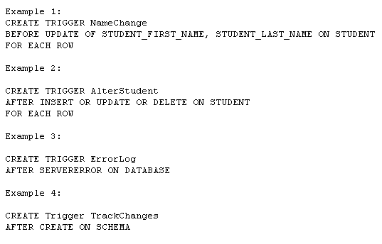
Event Examples

Slide 16
Triggers
Conditions Available So Multiple Operations Can Be Dealt With In Same Trigger
Inserting, Updating, Deleting
Column Prefixes Allow Identification Of Value Changes
New, Old

Slide 17
Triggers Exceptions
EXCEPTION Data Type Allows Custom Exceptions
RAISE Allows An Exception To Be Manually Occur
RAISE_APPLICATION_ERROR Allows Termination Using A Custom Error Message
Must Be Between -20000 and -20999
Message Can Be Up to 512 Bytes

